Slide 1


Analytics, Technology, Digital

Slide 2
Executive Summary
Completions project at Devon
Objective
Build a mobile or desktop application that can be used on field sites by Devon’s Person in Charge (PIC) to improve operational decisions or behaviors, during hydraulic fracturing.
Special consideration should be given to unique, creative visualizations and the incorporation of gamification of the interface
1
2
Business Impact / Benefits
Improve PIC on job productivity and enable quicker decision making process
Enable real time collaboration between “well contractors, site engineer, PIC and control station”
Use real time data to provide meaningful business insights
Minimize on site job accidents
Improve site efficiency resulting in betterment of Devon’s bottom line
1
2
3
4
5

Slide 3
Executive Summary
Project Economics and attributes impacting completion
Completions projects are cost intensive and has a direct impact on Devon’s bottom line and profitability.
Project consists of nearly 30 stages and each stage can cost $200K
Screen-outs currently cost Devon ~ $250K
Cost / hour for fracking is ~$20K
Currently project economics are reviewed by corporate teams. Review at stage level is not conducted
PIC and Engineers do not have access to stage level project economics
Notes:
PI data attributes
Time
Treating pressure
Injection pressure (barrels / minute) -> Slurry rate
Surface sand concentration
Calculated bottom hole sand concentration
Chemicals including FR, Gel and Crosslinker

Slide 4




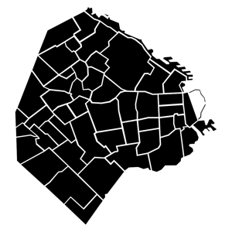
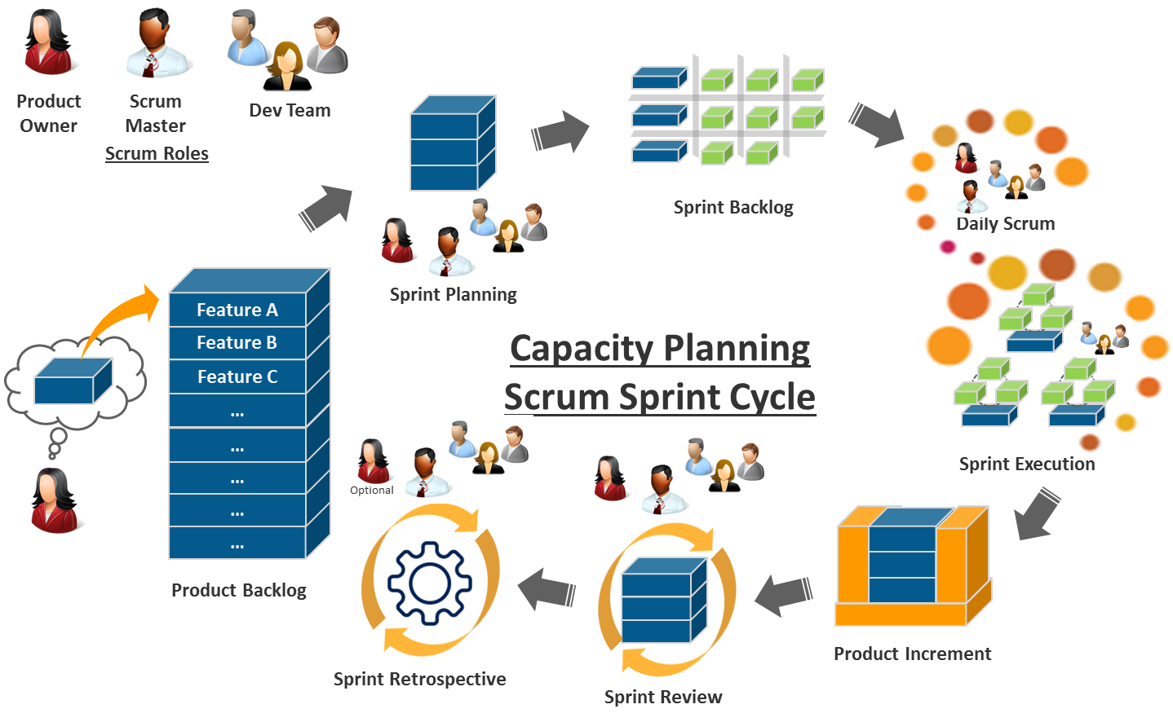
Our Solution Approach
Devon values and use of Agile Methodology
Devon Values
Hire the best people
Always do the right thing
Deliver results
Be a team player
Be a good neighbor
Agile Methodology
We used an agile approach to develop a minimal viable product. The reason that we used this approach is that we believe it’s critical for both the business and technology teams to collaborate with each other as this app is progressed.
Completions Application
Sprint Cycle
Agile Teams
Completions Team
Exploration Geo Steering
Technology Team
4. PIC SMEs
5. Real time monitoring team
6. Data and Analytics

Slide 5



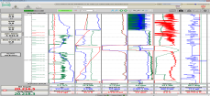


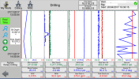
Conceptual Architecture Diagram
Local Desktop Visualization
Real Time Center Desktop Visualization
Well Master Data
Real Time Data Feed
Real Time Center Mobile Visualization
Completions Service Provider
Field Data Aggregator
Data Aggregator Server
Local
Analytics Engine
Central Analytics Engine
Completions Engineer Desktop Visualization
Local Mobile Visualization
Aggregates data from from multiple wells
Survey Data
Completions Engineer Mobile Visualization

Slide 6
Devon’s Completion App
Wireframe and visualization
Our app focuses on two personas - (1) the person in charge (PIC) and (2) and also those in the business responsible for project economics that would include wells that are being completed in the field and wells already producing in the same field.
App Functionality
Quick/Current sensor reading
Well bore locations & key mechanical details stage info including timeclock
Screen-out warnings
Simulation for Optimization
Formation characteristics of current location in wellbore
Rapid PIC Communication
Notes:
Enhanced Functionality: Project View (Field Impact vs. Well Impact)
Incremental financial improvement of fracking process using integrated machine learning

Slide 7


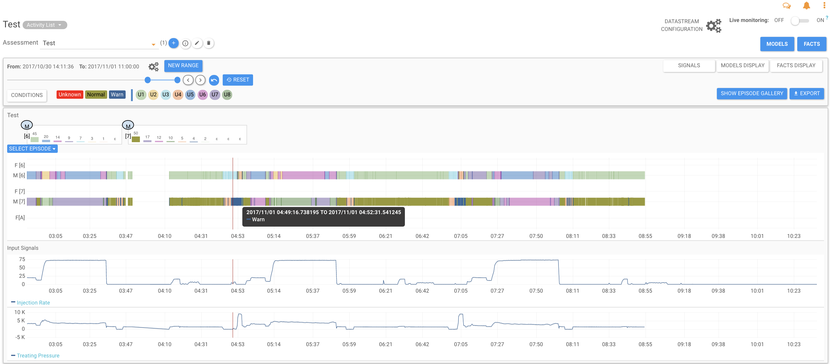

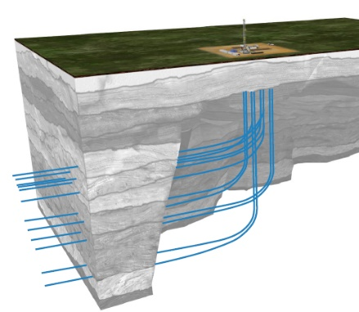




Alternative Solution: Falkonry
Utilize Automated Machine Learning To Optimize Resources
Use Falkonry To Aggregate Machine Learning Insights From Completion(s) Site & Off-Set Wells
+
Compare operational performance of off-set wells with well being completed in real-time; optimize the financial value of off-set wells with those being completed
Expedite data availability to centralized engineers to make decisions regarding future fracking activities
Use comparative data to improve efficiencies of future completed wells
PI System™
Data Aggregator Server
Completion Solution Provider
Offset Wells
Example Of Warning Two Different System Sources
Falkonry Partners Are Also Devon Partners

Slide 8



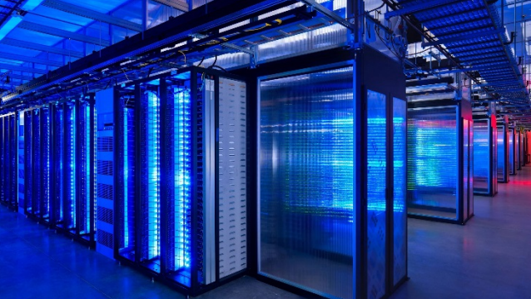
“It had long since come to my attention that people of accomplishment rarely sat back and let things happen to them. They went out and happened to things”
Leonardo da Vinci
Evolution
Experience
Culture
Information

